Slide 1
WebSphere Application Server v6.1
Introduction

Slide 2
Agenda
Introduction
Team
Plan for the Week
Some Useful Information
Summary

Slide 3
Sales and Technical Sales Enablement Workshops
The STEW is a lab exercise-oriented workshop which will teach you what you need to know to support technical sales of WebSphere Application Server v6.1
The STEW rolls out before eGA
  All presentations and labs now updated for eGA
The STEW provides
  Reusable presentations
  Extensible hands-on labs
  Sales and technical sales information
  Focuses on the 4-5 features customers want
Technical sales enablement, not technical enablement

Slide 4
Worldwide WebSphere Technical Sales Mission
Worldwide technical sales support and enablement team supporting WebSphere products
Work with AP, EMEA, and Americas geographies to make revenue targets
Perform Enablement and Engagement activities
Build worldwide virtual communities of recognized technical specialists
Represent the field and customers to development

Slide 5
Introductions -- Your STEW Team
Worldwide WebSphere Technical Sales
  Tom Alcott
      Thomas Alcott/Costa Mesa/IB
  Warren Hill
      Warren Hill/Billings/IBM
  Roman Kharkovski
      Roman Kharkovski/Pittsburgh/IBM
  Ken Klingensmith
      Ken Klingensmith/Costa Mesa/IBM
  Melissa Pike
    Melissa Pike/San Diego/IBM
  Bob Ringo
      Robert Ringo/Somers/IBM
  Jeff Sampson
      Jeffrey Sampson/Somers/IBM

Slide 6
Introductions -- tell us about yourself
Name
Where you live
What’s your position and roll in IBM
How much time do you spend with the Application Server ?
  Full-time
  Part-time (e.g. some WAS and some Process Server)
  Very little time

Slide 7
Plan
Day1 By Uday & Anbuvel
  Introduction
  Technical Overview
  Installation and Packaging
    Installation and Configuration Lab
  Application Server Toolkit
    AST Lab
  WebSphere Rapid Application Deployment

Slide 8
Plan
Day 2 By Uday & Anbuvel
  Portlet Support
    Portlet Lab
  Messaging
    Messaging Lab
  Application Management
    Lab on Application Management

Slide 9
Plan
Day 3 By Kasi & Anbuvel
  IBM JDK 5 and Performance
  Web Services Overview
    Lab Web Services
  Security Overview
    Lab Security Lab
  Session Initiation Protocol Overview

Slide 10
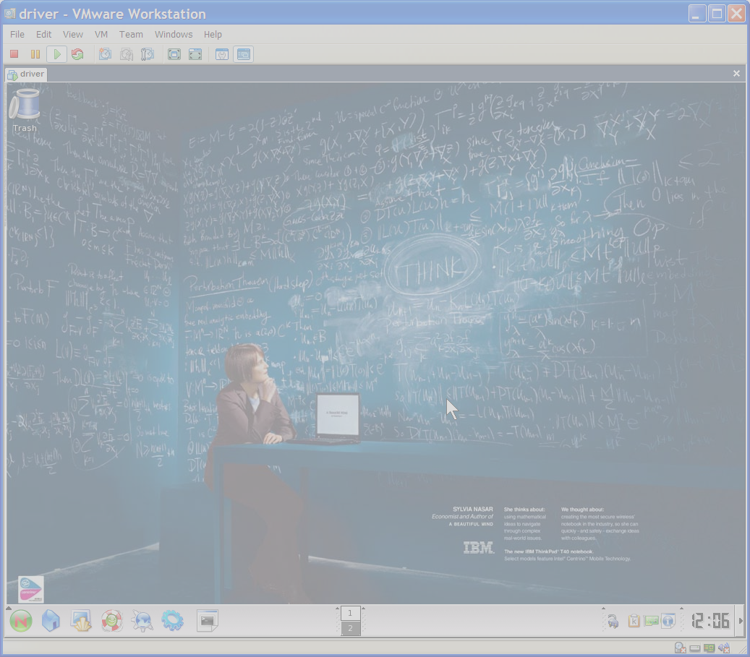
Lab environment
Things to know…
  All labs use VMware
  You need either
    Workstation v5.51
    Player v1.01 (free)

Slide 11
Lab environment
The labs are independent
  i.e. You do not need to successfully finish Lab01 to start Lab02
Please tell us of any mistakes in the labs
  Typo’s
  Lab is not working correctly…
Feel free to experiment with the labs and WAS v6.1
  Greater learning and understanding
  Easy to recover from any mistakes since it’s a VMware image

Slide 12

Linux image
Authentication
  The userid is "root“. The password is "password“
On a Windows host, your C:\ is shared with the image
  Access in the Linux image at /mnt/hgfs/Shared
To reconfigure the screen resolution
  From a command prompt
    # vmware-config-tools.pl
      Answer yes to the initial questions
      Do you want to change your guest X resolution? Yes
      Choose 1400x1050, or whatever you’d like
      Logout / Login to restart X server
# ping hostA on first startup
  If no network available – let us know
Command Prompt
firefox
db2pe
eclipse

Slide 13
Some Useful Information
STEW Site:
  http://ausgsa.ibm.com/~wwbistew/stew/stew2006/
  http://ausgsa.ibm.com/~wwbistew/stew/stew2006/WASv61/
WSDDi
  http://submit.boulder.ibm.com/wsdd
WebSphere Application Server Virtual Community
  WebSphere Central “VC – WebSphere Application Server”
    D27DBL06/27/A/IBM; w_dir\WSCentral.nsf
How to engage the Worldwide team
  WW Business Integration Tech Sales/Hartford/IBM

Slide 14
Summary
BE HERE NOW.
You have wireless access. But please close Lotus Notes. Shutdown Sametime. Mute cellphones. Focus!
Learn now, especially the WHY
  You have the experts available
  If we can not answer immediately, we will research and provide a response.
We will be asking you complete an evaluation
  We require 100% feedback – we value your input!
Thanks for coming and enjoy the STEW!

Slide 15
Thank you

